Slide 1
External Sorting
R&G Chapter 13
“There it was, hidden in alphabetical order.”
Rita Holt
Notes:
1
The slides for this text are organized into chapters. This lecture covers Chapter 11.
Chapter 1: Introduction to Database Systems
Chapter 2: The Entity-Relationship Model
Chapter 3: The Relational Model
Chapter 4 (Part A): Relational Algebra
Chapter 4 (Part B): Relational Calculus
Chapter 5: SQL: Queries, Programming, Triggers
Chapter 6: Query-by-Example (QBE)
Chapter 7: Storing Data: Disks and Files
Chapter 8: File Organizations and Indexing
Chapter 9: Tree-Structured Indexing
Chapter 10: Hash-Based Indexing
Chapter 11: External Sorting
Chapter 12 (Part A): Evaluation of Relational Operators
Chapter 12 (Part B): Evaluation of Relational Operators: Other Techniques
Chapter 13: Introduction to Query Optimization
Chapter 14: A Typical Relational Optimizer
Chapter 15: Schema Refinement and Normal Forms
Chapter 16 (Part A): Physical Database Design
Chapter 16 (Part B): Database Tuning
Chapter 17: Security
Chapter 18: Transaction Management Overview
Chapter 19: Concurrency Control
Chapter 20: Crash Recovery
Chapter 21: Parallel and Distributed Databases
Chapter 22: Internet Databases
Chapter 23: Decision Support
Chapter 24: Data Mining
Chapter 25: Object-Database Systems
Chapter 26: Spatial Data Management
Chapter 27: Deductive Databases
Chapter 28: Additional Topics

Slide 2
Why Sort?
A classic problem in computer science!
Data requested in sorted order
  e.g., find students in increasing gpa order
Sorting is first step in bulk loading B+ tree index.
Sorting useful for eliminating duplicate copies in a collection of records (Why?)
Sorting is useful for summarizing related groups of tuples
Sort-merge join algorithm involves sorting.
Problem: sort 100Gb of data with 1Gb of RAM.
  why not virtual memory?
Notes:
4

Slide 3

Streaming Data Through RAM
An important method for sorting & other DB operations
Simple case:
  Compute f(x) for each record, write out the result
  Read a page from INPUT to Input Buffer
  Write f(x) for each item to Output Buffer
  When Input Buffer is consumed, read another page
  When Output Buffer fills, write it to OUTPUT
Reads and Writes are not coordinated
  E.g., if f() is Compress(), you read many pages per write.
  E.g., if f() is DeCompress(), you write many pages per read.
Input
Buffer
Output
Buffer
INPUT
f(x)
OUTPUT
RAM

Slide 4
2-Way Sort: Requires 3 Buffers
Pass 0: Read a page, sort it, write it.
  only one buffer page is used (as in previous slide)
Pass 1, 2, 3, …, etc.:
  requires 3 buffer pages
  merge pairs of runs into runs twice as long
  three buffer pages used.
INPUT 1
OUTPUT
INPUT 2
Main memory buffers
Disk
Disk
Notes:
5

Slide 5
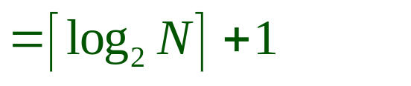
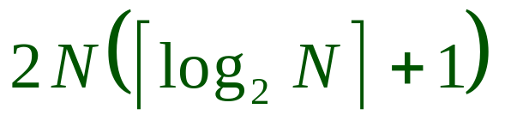
Two-Way External Merge Sort
Each pass we read + write each page in file.
N pages in the file => the number of passes
So total cost is:
Idea: Divide and conquer: sort subfiles and merge
3,4
6,2
9,4
8,7
5,6
3,1
2
Input file
PASS 0
3,4
2,6
4,9
7,8
5,6
1,3
2
1-page runs
PASS 1
2,3
4,7
1,3
2-page runs
4,6
8,9
5,6
2
PASS 2
2,3
4,4
1,2
4-page runs
6,7
3,5
8,9
6
PASS 3
1,2
2,3
3,4
8-page runs
4,5
6,6
7,8
9
Notes:
6

Slide 6

General External Merge Sort
More than 3 buffer pages. How can we utilize them?
To sort a file with N pages using B buffer pages:
  Pass 0: use B buffer pages. Produce sorted runs of B pages each.
  Pass 1, 2, …, etc.: merge B-1 runs.
INPUT 1
. . .
INPUT 2
. . .
. . .
OUTPUT
INPUT B-1
Disk
Disk
B Main memory buffers
Notes:
7

Slide 7
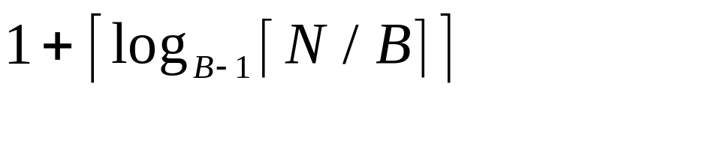
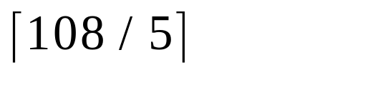
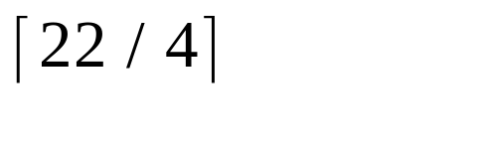
Cost of External Merge Sort
Number of passes:
Cost = 2N * (# of passes)
E.g., with 5 buffer pages, to sort 108 page file:
  Pass 0: = 22 sorted runs of 5 pages each (last run is only 3 pages)
  Pass 1: = 6 sorted runs of 20 pages each (last run is only 8 pages)
  Pass 2: 2 sorted runs, 80 pages and 28 pages
  Pass 3: Sorted file of 108 pages
Formula check: ┌log₄ 22┐= 3 … + 1 → 4 passes √
Notes:
8

Slide 8
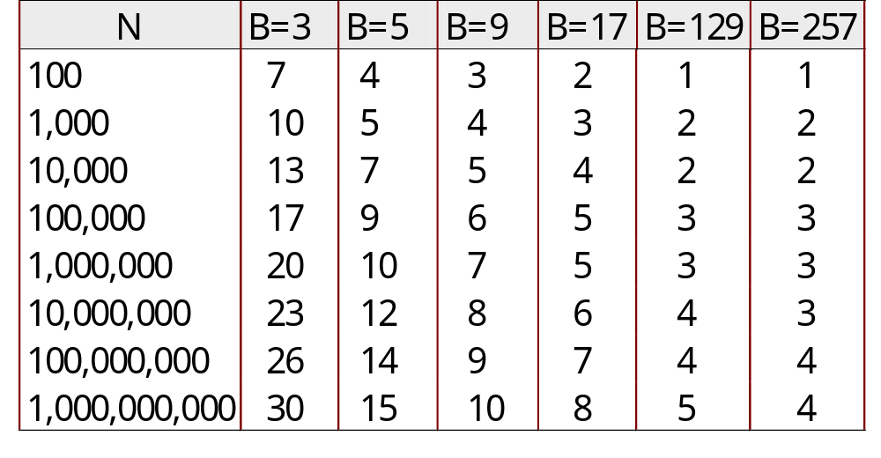
Number of Passes of External Sort
( I/O cost is 2N times number of passes)
Notes:
9

Slide 9
Internal Sort Algorithm
Quicksort is a fast way to sort in memory.
Alternative: “tournament sort” (a.k.a. “heapsort”, “replacement selection”)
Keep heap H in memory
  read B-2 pages of records, inserting into H;
  while (records left) {
  m = H.removeMinUnmarked (); append m to output buffer;
  if (m=NULL => all entries in H are marked) {
  H.unmark(all);
  start new output run;
  } else {
  read in new record r (use 1 buffer for input pages);
  H.insert(r at m’s position);
  if (r < m) H.mark(r);
  }
  }
Notes:
10

Slide 10
More on Heapsort
Fact: average length of a run in heapsort is 2(B-2)
  The “snowplow” analogy
Worst-Case:
  What is min length of a run?
  How does this arise?
Best-Case:
  What is max length of a run?
  How does this arise?
Quicksort is faster, but ... longer runs often means fewer passes!
B

Slide 11
I/O for External Merge Sort
Do I/O a page at a time
  Not one I/O per record
In fact, read a block (chunk) of pages sequentially!
Suggests we should make each buffer (input/output) be a block of pages.
  But this will reduce fan-in during merge passes!
  In practice, most files still sorted in 2-3 passes.

Slide 12
Double Buffering
To reduce wait time for I/O request to complete, can prefetch into `shadow block’.
  Potentially, more passes; in practice, most files still sorted in 2-3 passes.
INPUT 1
INPUT 1'
INPUT 2
OUTPUT
INPUT 2'
OUTPUT'
b
Disk
INPUT k
block size
Disk
INPUT k'
B main memory buffers, k-way merge

Slide 13
Using B+ Trees for Sorting
Scenario: Table to be sorted has B+ tree index on sorting column(s).
Idea: Can retrieve records in order by traversing leaf pages.
Is this a good idea?
Cases to consider:
  B+ tree is clustered Good idea!
  B+ tree is not clustered Could be a very bad idea!
Notes:
15

Slide 14
Clustered B+ Tree Used for Sorting
Cost: root to the left-most leaf, then retrieve all leaf pages (Alternative 1)
If Alternative 2 is used? Additional cost of retrieving data records: each page fetched just once.
Index
(Directs search)
Data Entries
("Sequence set")
Data Records
Always better than external sorting!
Notes:
16

Slide 15
Unclustered B+ Tree Used for Sorting
Alternative (2) for data entries; each data entry contains rid of a data record. In general, one I/O per data record!
Index
(Directs search)
Data Entries
("Sequence set")
Data Records
Notes:
17

Slide 16
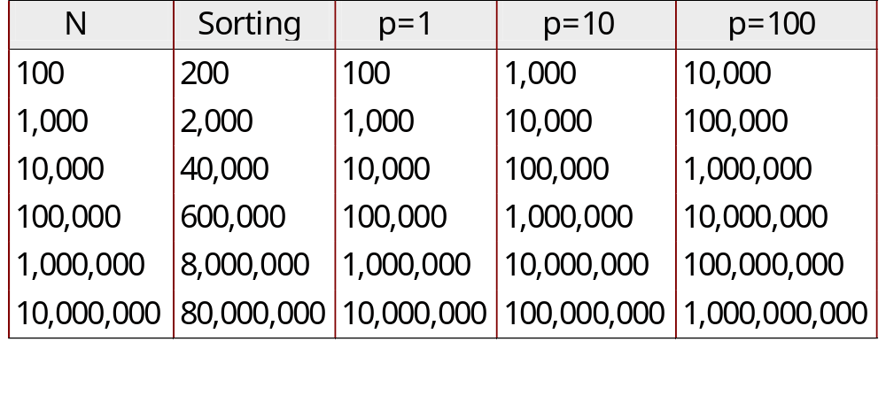
External Sorting vs. Unclustered Index
p: # of records per page
B=1,000 and block size=32 for sorting
p=100 is the more realistic value.
Notes:
18

Slide 17
Summary
External sorting is important
External merge sort minimizes disk I/O cost:
  Pass 0: Produces sorted runs of size B (# buffer pages). Later passes: merge runs.
  # of runs merged at a time depends on B, and block size.
  Larger block size means less I/O cost per page.
  Larger block size means smaller # runs merged.
  In practice, # of runs rarely more than 2 or 3.
Notes:
19

Slide 18
Summary, cont.
Choice of internal sort algorithm may matter:
  Quicksort: Quick!
  Heap/tournament sort: slower (2x), longer runs
The best sorts are wildly fast:
  Despite 40+ years of research, still improving!
Clustered B+ tree is good for sorting; unclustered tree is usually very bad.

